Slide 1
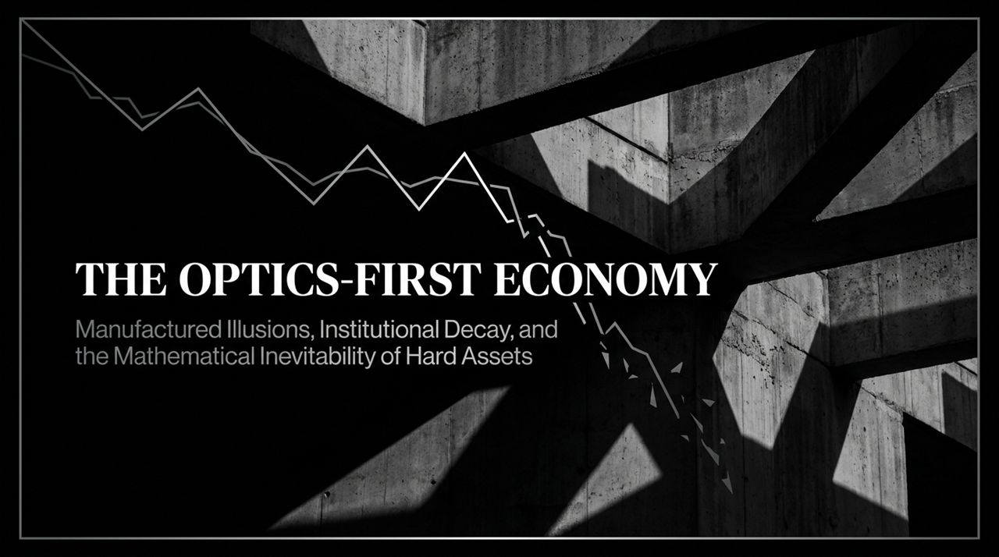
Notes:
Good morning, everyone. Welcome to today’s presentation on The Optics-First Economy: Manufactured Illusions, Institutional Decay, and the Mathematical Inevitability of Hard Assets.
The core thesis of this deck revolves around a dangerous decoupling happening across two fronts: financial markets and government state institutions. In financial markets, investors and media are prioritizing headlines and index optics while ignoring severe underlying structural decay—specifically record yield pressures and extreme concentration. In our state institutions, regulators are prioritizing high-profile public relations victories over constitutional due process and actual consumer protection.
Throughout history, whenever a system optimizes strictly for "optics" over underlying mathematical truth, the facade eventually cracks. When optics fail, only hard math remains. Over the next 45 minutes, we will unpack the data behind the stock market's hidden bear market, deconstruct the demand-side reality of interest rates, examine an alarming case study of regulatory overreach, and trace the inescapable capital rotation into hard assets.
86% of Stocks Are in a Bear Market... The S&P Hides It
https://www.youtube.com/watch?v=GEGgSywAHlk

Slide 2
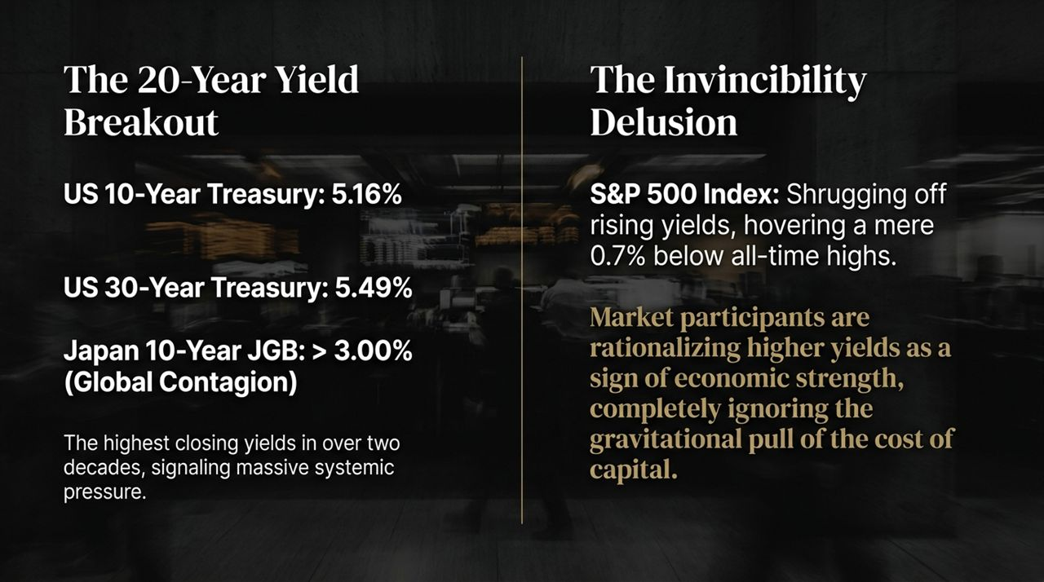
Notes:
Let's begin by looking at the fixed-income landscape. What we are witnessing in the bond market right now is nothing short of historic.
US 10-Year Treasury yields closed at 5.16%, touching intraday highs of 5.22%. Meanwhile, the US 30-Year Treasury yield hit 5.49%, with intraday peaks of 5.53%. These are the highest closing bond yields on a closing basis in over two decades. Even shorter-term paper, like the 5-Year and 2-Year Treasuries, have crossed or are flirting with 5%.
Crucially, this is not just a domestic issue; it is a global contagion. If you look across the Pacific, Japan’s 10-Year Japanese Government Bond (JGB) yield has settled above 3.00%—a monumental shift for a nation that maintained negative and zero-interest-rate policies for decades. Japan's 30-year bond hit 4.13%, an all-time record high.
Rising yields are the absolute benchmark for the global cost of capital. When yields spike to 20-year highs, every single financial model, debt service calculation, and valuation metric in the global economy experiences massive systemic pressure. Yet, as we'll see on the next slide, equity markets are behaving as if none of this matters.

Slide 3
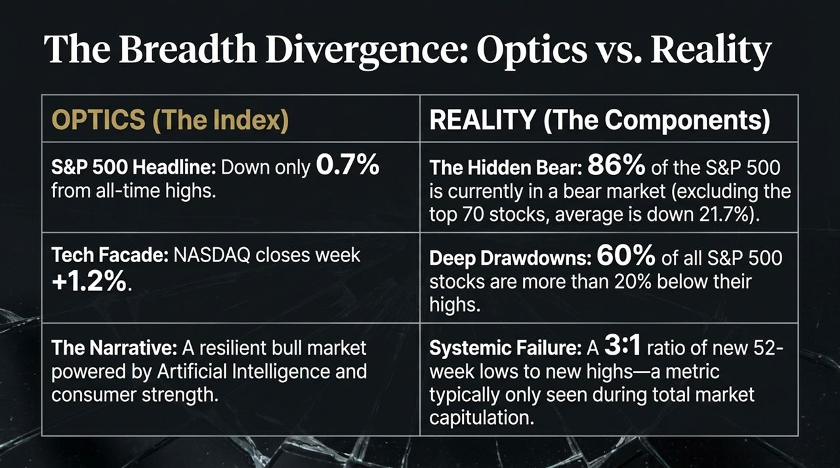
Notes:
Despite the historic surge in borrowing costs, the headline S&P 500 index is hovering a mere 0.7% below its all-time highs.
Market participants and mainstream financial commentators are engaged in what can only be called the "Invincibility Delusion." They are actively rationalizing higher bond yields as a sign of economic resilience and consumer strength rather than a tightening cost of capital. They claim, "The economy is so strong that businesses and consumers can simply pay 5.5% on debt without breaking a sweat."
This rationalization ignores basic economic gravity. Capital has a cost. When risk-free Treasuries yield over 5.5%, they present direct competition to risk equities. Furthermore, high rates act as an inescapable brake on corporate profit margins and consumer spending. The market’s refusal to price in rising yields is not rational valuation—it is willful ignorance and wishful thinking fueled by narrative-chasing.

Slide 4
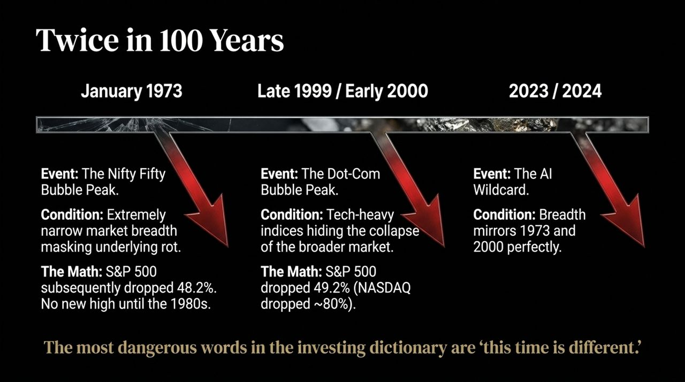
Notes:
To understand why the headline S&P 500 appears invincible, we must peer beneath the surface and examine market breadth. The headline index is a manufactured optical illusion.
On the left side of this slide, you see the OPTICS: The S&P 500 headline index is down only 0.7% from record highs. The NASDAQ closed up 1.2% in a single week. Media narratives attribute this strength to endless Artificial Intelligence momentum and consumer resilience.
Now look at the right side—the REALITY:
The Hidden Bear: If you remove the top 70 mega-cap stocks from the S&P 500, the remaining 430 stocks are down an average of 21.7% from their highs. That means 86% of the S&P 500 is technically trapped in a bear market.
Deep Drawdowns: Broadly speaking, 60% of all individual stocks within the S&P 500 are in official bear markets, trading more than 20% off their peaks.
Systemic Capitulation Metrics: In a healthy bull market at record highs, stock advances far outpace declines. Yet, last week saw 41 S&P stocks hit new 52-week lows against only 14 hitting new highs—a 3:1 ratio of new lows to new highs.
A 3:1 ratio of new lows to new highs usually occurs during total market capitulation, yet it is happening while the headline index sits near record highs. A tiny hand-full of mega-cap "generals" are marching upward while the vast majority of the "troops" are retreating.

Slide 5
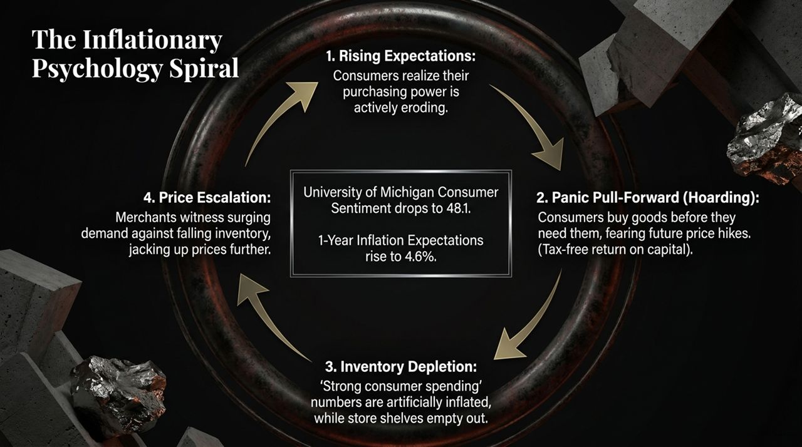
Notes:
Severe breadth divergence of this magnitude is extremely rare. In fact, across the last 100 years of US financial history, market breadth has reached this level of extreme decay only twice before.
1. January 1973 (The Nifty Fifty Bubble): During the late 1960s and early 1970s, investors piled exclusively into 50 institutional darling stocks (the "Nifty Fifty"), ignoring broader economic weakness. Narrow market breadth masked severe underlying rot. Once the illusion cracked, the S&P 500 collapsed by 48.2%, launching a brutal bear market that took until the early 1980s to recover.
2. Late 1999 / Early 2000 (The Dot-Com Bubble): Tech-heavy mega-caps surged while the average stock was already declining. Once again, narrow participation masked systemic risk. The resulting crash saw the S&P 500 fall 49.2%, while the NASDAQ plummeted nearly 80%.
3. Present Day (2023/2024 - The AI Wildcard): Today's breadth divergence mirrors 1973 and 2000 almost perfectly. Today's bull argument relies on the idea that "AI productivity gains make this time different." But as Sir John Templeton famously warned, "The most dangerous words in investing are 'this time is different.'" History demonstrates that when 86% of the market breaks down, the headline index eventually follows.

Slide 6
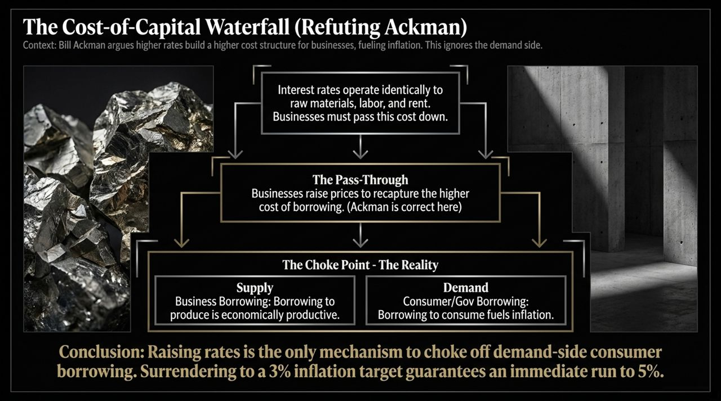
Notes:
While equity markets ignore interest rates, consumer sentiment is breaking down due to sticky, embedded inflation.
Recent data from the University of Michigan Consumer Sentiment survey showed sentiment plunging from 51.7 to 48.1. More alarmingly, 1-Year Inflation Expectations jumped sharply from 4.0% to 4.6%. This shift signals the start of a dangerous self-fulfilling economic loop known as the Inflationary Psychology Spiral:
Rising Expectations: Consumers realize their purchasing power is actively eroding.
Panic Pull-Forward (Hoarding): Fearing that goods will cost 10% or 15% more next year, consumers buy goods today before they actually need them. Buying a non-perishable good today to avoid a 10% price hike next year provides a 10% tax-free return on capital.
Inventory Depletion & Artificial Spending: Headline "consumer spending" numbers look strong on paper, but they are artificially inflated by panic buying. Consequently, store shelves begin to empty.
Price Escalation: Merchants witness surging demand against falling inventories, prompting them to mark up prices even faster.
This psychology creates a feedback loop that cannot be solved by rosy government economic press releases.

Slide 7
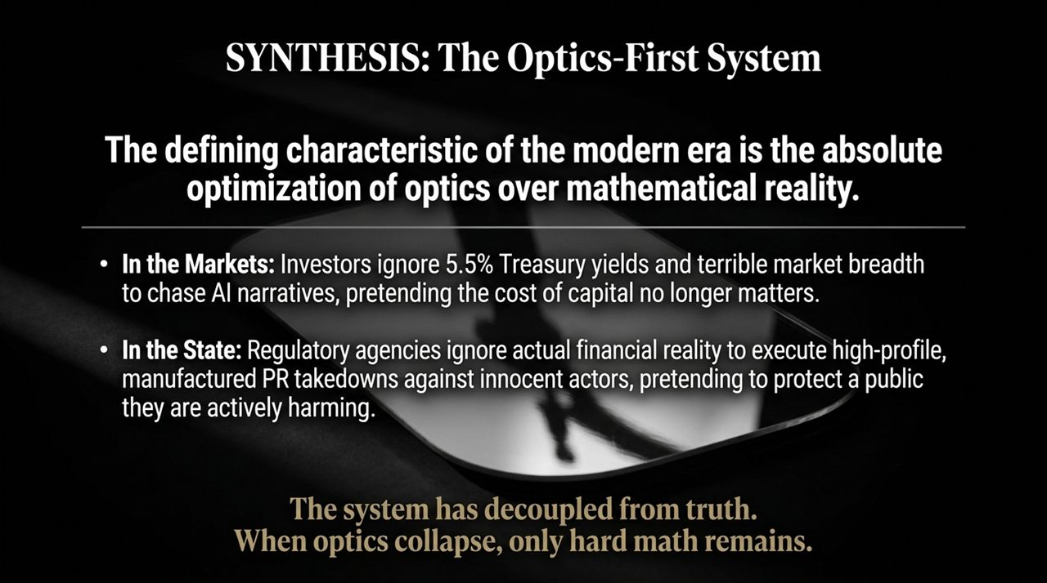
Notes:
There is an active debate among high-profile market figures regarding how interest rates impact inflation. Prominent investor Bill Ackman recently argued that the Fed should cease raising interest rates and raise its inflation target from 2% to 3%. His logic? Higher borrowing costs increase operating expenses for businesses, which forces them to raise prices on consumers, thus fueling inflation.
Ackman’s argument is half-correct on supply, but entirely wrong on demand:
The Pass-Through (Supply Side): Interest rates are indeed an operational cost, identical to raw materials, labor, and rent. When borrowing costs rise, businesses attempt to pass these costs down to consumers to protect profit margins. Ackman is correct here.
The Demand Choke Point: However, rates exist primarily to constrain demand. Business borrowing to build productive capital expands supply. Consumer and government borrowing to fund current consumption fuels demand and drives inflation.
Raising rates is the only mechanism available to choke off consumer and government credit-fueled spending. Surrendering to a 3% inflation target doesn't stabilize prices; it unanchors expectations, guaranteeing a rapid run-up to 5% or higher.

Slide 8
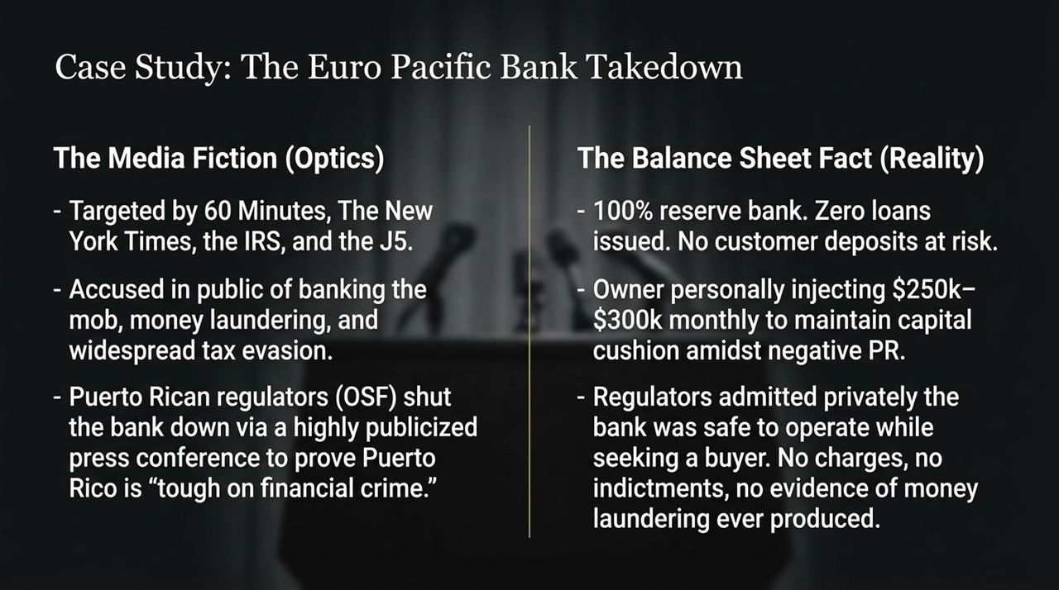
Notes:
When we combine these observations, a clear pattern emerges: the defining characteristic of our modern system is the complete optimization of optics over mathematical reality.
In the Markets: Investors pretend that 5.5% Treasury yields and a 21.7% draw-down across 430 S&P stocks don't matter, choosing instead to bid up mega-cap AI headlines.
In the State: Government agencies increasingly ignore operational facts and financial health, focusing instead on manufactured PR enforcement actions designed to display strength to the public, regardless of the destruction caused.
The broad financial and regulatory system has decoupled from fundamental truth. But mathematical reality cannot be suppressed indefinitely. When manufactured illusions inevitably collapse under their own weight, only balance-sheet reality and hard assets remain.

Slide 9
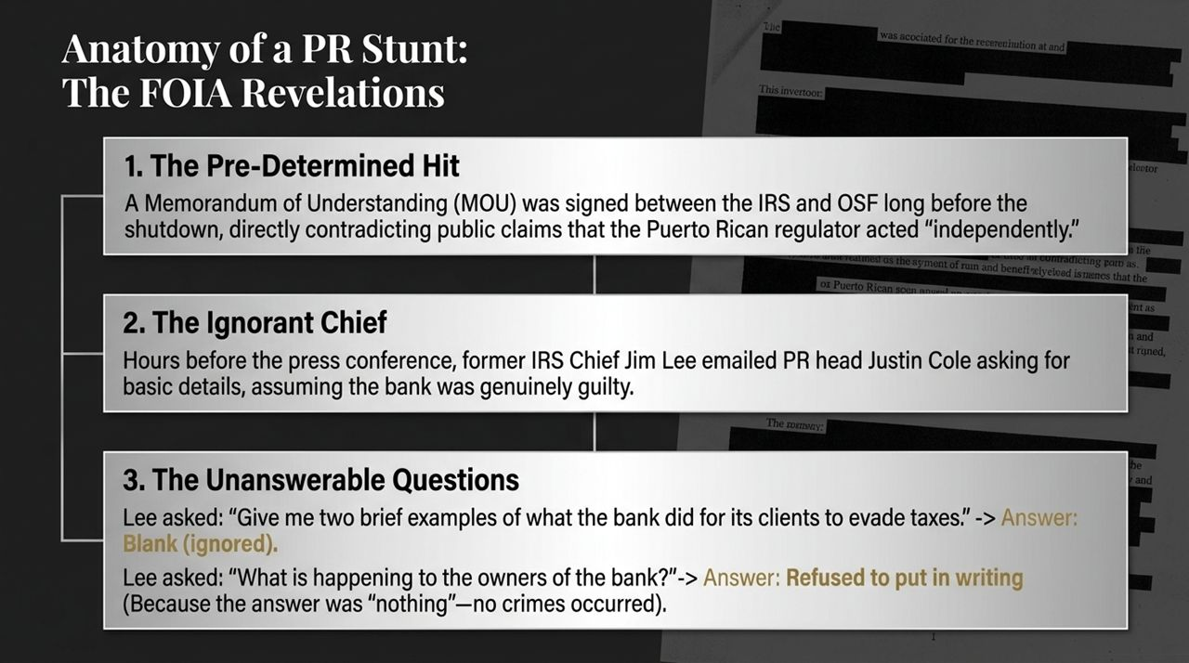
Notes:
To illustrate how "optics-first" government enforcement functions in practice, let's examine a concrete case study: the regulatory shutdown of Euro Pacific Bank.
On the left, we see The Media Fiction (Optics):
In 2020, Euro Pacific Bank was targeted by coordinated media reports, including 60 Minutes Australia and The New York Times, alongside the IRS and J5 taskforce. Public allegations claimed the bank was facilitating tax evasion, money laundering, and organized crime. Puerto Rican regulator OSF staged a high-profile press conference announcing the bank’s immediate shutdown, framing it as proof that Puerto Rico was "getting tough on financial crime."
On the right, we see The Balance Sheet Fact (Reality):
Euro Pacific was a 100% reserve bank. It issued zero loans and held 100% of customer deposits in cash or safe liquid instruments. No customer funds were ever at risk. The bank's owner was personally injecting $250,000 to $300,000 per month of private capital to maintain regulatory capital cushions despite media-driven revenue hits.
During the shutdown, regulators privately acknowledged the bank was safe to operate while seeking a buyer. Ultimately, no criminal charges, indictments, or evidence of money laundering were ever produced. The shutdown was executed for optics.

Slide 10
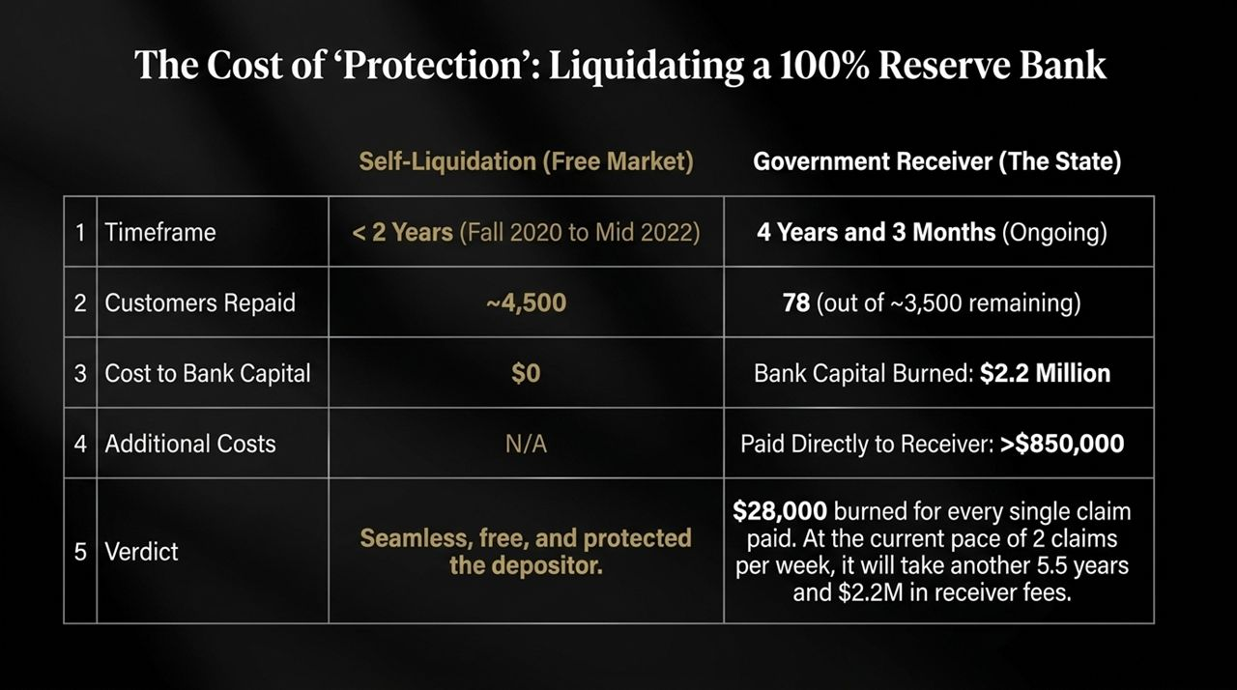
Notes:
Following the shutdown, Freedom of Information Act (FOIA) requests and subsequent legal action uncovered internal IRS emails that revealed how the enforcement action was handled internally:
The Pre-Determined Hit: A Memorandum of Understanding (MOU) was signed between the IRS and OSF long before the shutdown took place. This directly contradicted public press conference claims that local Puerto Rican regulators acted independently based on standalone audit findings.
The Ignorant Chief: Hours before stepping onto the stage for the global press conference, former IRS Criminal Investigation Chief Jim Lee emailed IRS PR Head Justin Cole asking basic questions about what the bank had actually done wrong. Chief Lee genuinely assumed the bank was guilty of massive tax crimes and requested specific examples to share with reporters.
The Unanswerable Questions: IRS agent Gary Shapley was tasked with answering Lee's questions. When Lee asked, "Give me two brief examples of what the bank did for its clients to evade taxes," the line was left completely BLANK—because no examples existed. When asked what was happening to the owner of the bank, IRS officials refused to answer in writing, stating it was "better discussed verbally," because the truthful answer was "nothing"—no crime had occurred.

Slide 11
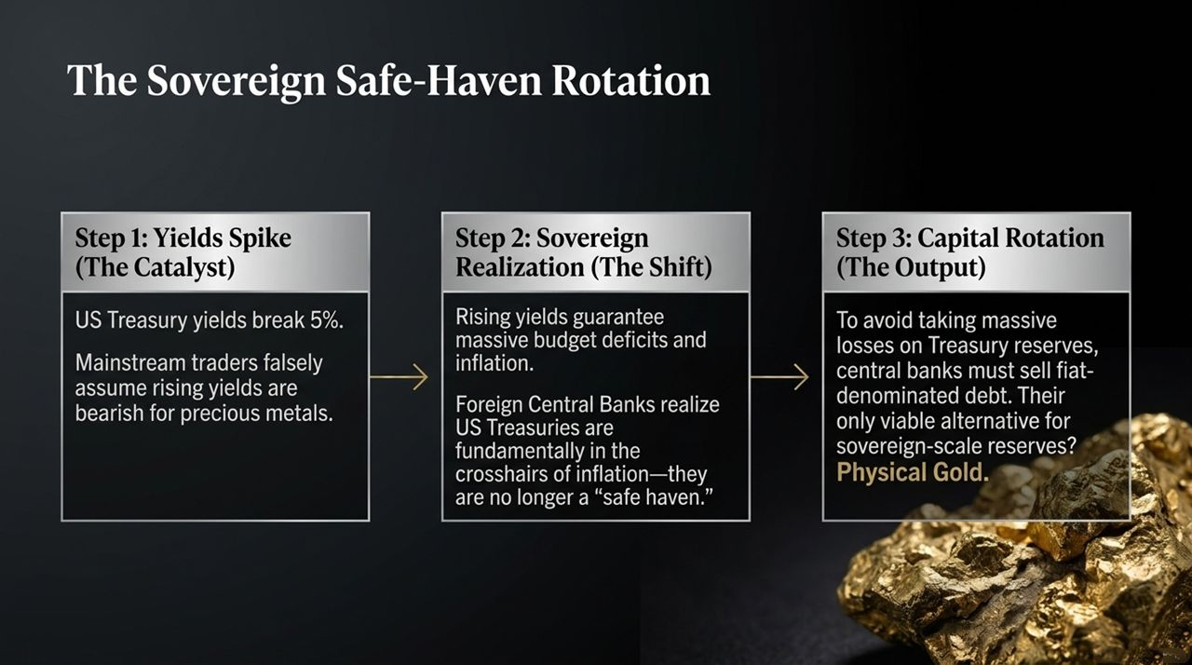
Notes:
The real tragedy of optics-first regulatory actions is the severe financial damage inflicted on the very depositors the government claims to protect. Let's compare the free-market self-liquidation process against government receivership:
Self-Liquidation (Free Market): Following initial negative press in late 2020, Euro Pacific Bank processed account closures for approximately 4,500 customers, returning 100% of their capital seamlessly in under two years. Cost to taxpayers or bank capital: $0.
Government Receiver (The State): In the 4 years and 3 months since the government appointed a receiver, the receiver has repaid only 78 out of ~3,500 remaining customers.
Capital Destruction: The receiver has burned through $2.2 million in bank capital, paying over $850,000 directly to himself in fees.
That breaks down to $28,000 in capital burned for every single customer claim paid. At the receiver's current pace of 2 claims per week, fully resolving the remaining accounts will take another 5.5 years and burn an additional $2.2 million in receiver fees. Government "protection" destroyed millions in depositor value to stage a PR press conference.

Slide 12
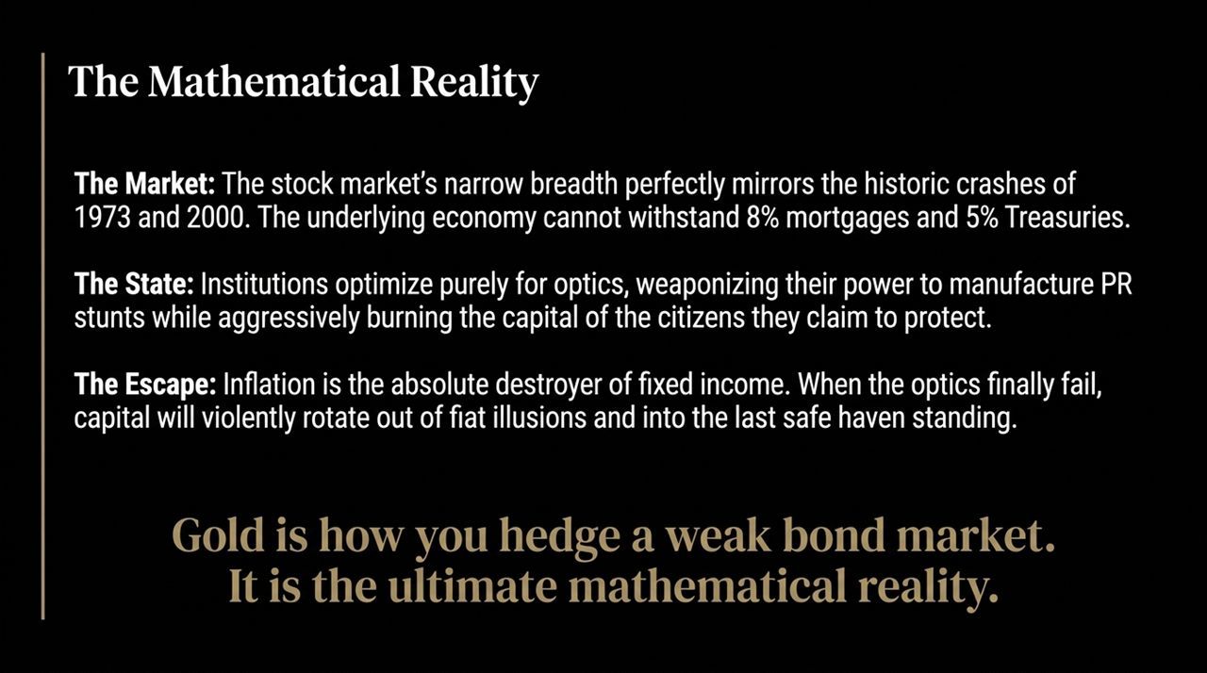
Notes:
Now let me pull these threads together—soaring bond yields, inflation expectations, and institutional decay—to show where global capital is forced to flow.
Step 1: Yields Spike (The Catalyst)
US Treasury yields break above 5.0% to 5.5%. Traditional market commentators assume rising yields are bearish for precious metals because high yields increase the opportunity cost of holding non-yielding gold. This is short-sighted.
Step 2: Sovereign Realization (The Shift)
Foreign central banks and sovereign wealth funds realize that surging yields guarantee massive budget deficits and mandatory monetary expansion (money printing) to service sovereign debt. Fiat debt assets like US Treasuries are sitting directly in the crosshairs of long-term inflation—they are no longer a risk-free safe haven.
Step 3: Capital Rotation (The Output)
To avoid absorbing compounding balance sheet losses on Treasury reserves, central banks must trim fiat-denominated debt. Their primary alternative for liquid, sovereign-scale, zero-counterparty-risk reserves is Physical Gold. Gold is not merely a commodity; it is how central banks hedge a collapsing bond market.

Slide 13
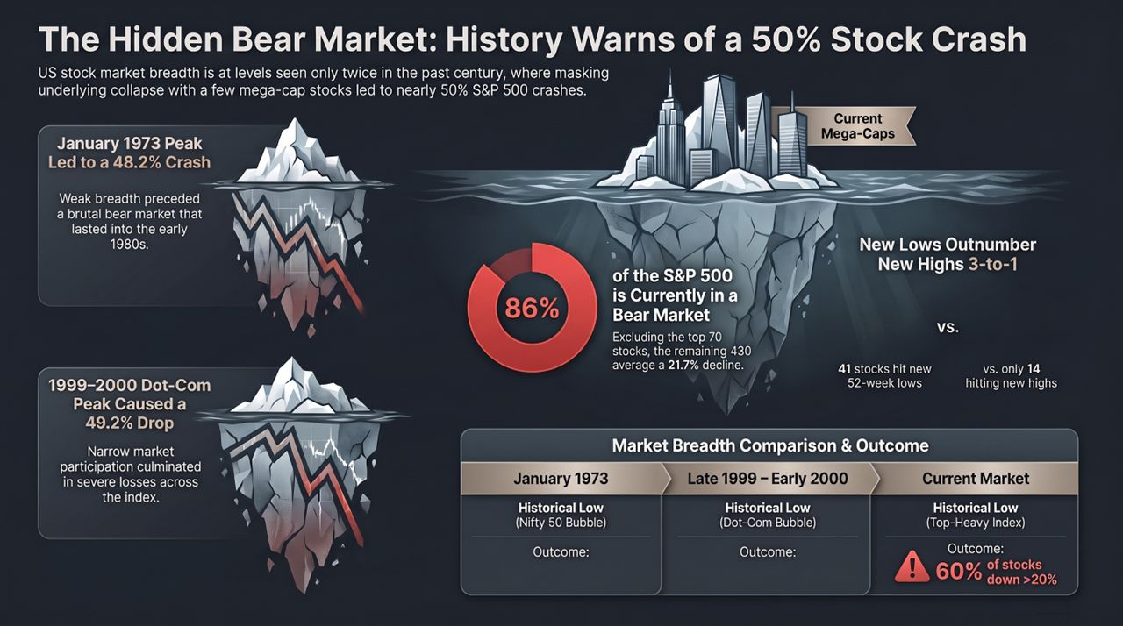
Notes:
To conclude our presentation, let’s summarize the mathematical realities that underpin our global macro landscape:
The Market Reality: Top-heavy index breadth mirrors the 1973 and 2000 bubble peaks. Broader economic realities—8% mortgage rates, 5.5% Treasury yields, and eroding consumer sentiment—cannot be obscured by a dozen mega-cap AI stocks forever.
The State Reality: Modern institutions regularly prioritize optics over systemic health, using enforcement power to manufacture PR wins while burning real capital.
The Investor Escape: Inflation erodes fixed-income debt. As the illusion of risk-free Treasuries and invincible headline indices cracks, global sovereign capital will continue rotating into tangible assets with zero counterparty risk.
Gold is the ultimate mathematical reality in an optics-first economy. Thank you very much. I will now open the floor to any questions.
86% of Stocks Are in a Bear Market... The S&P Hides It
https://www.youtube.com/watch?v=GEGgSywAHlk

